Slide 1


Introduction to Git and Github
Fall 2019 – CS 480

Slide 2
Brief Overview
Github Account and Homework Submission
Visualization of Git
Basic Git commands for quick workflow
Resources
Resources for Adv. workflows

Slide 3
Create Github Account
You will be making use of private repositories, which are free
Set up Repository
Add the cs480-680 account as collaborators
Push PA0 to your Github with the following instructions
Email the cs480-680 Gmail account to confirm.

Slide 4
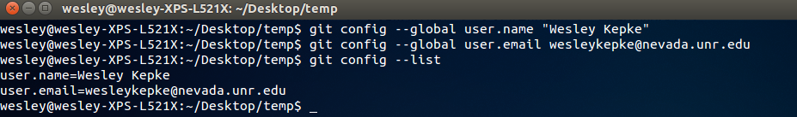
Local installation and setup
Installation
sudo apt-get update
sudo apt-get install git
Setup
git config --global user.name “Your Name”
git config --global user.email student@nevada.unr.edu
git config --list

Slide 5
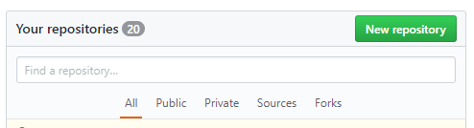
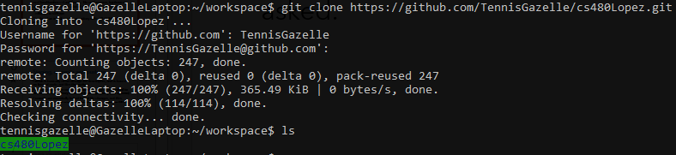
Creating your first repo
Go to github.com, and click on “New repository”
The repository name (not your username) will be in the form cs<ClassNumber><LastName>. No underscores, hyphens or spaces please; there are a lot of students, and this helps grading.
cs480Lopez or cs680Lopez
Download your repository to a common directory you will be using. This will be your workspace from now on.

Slide 6
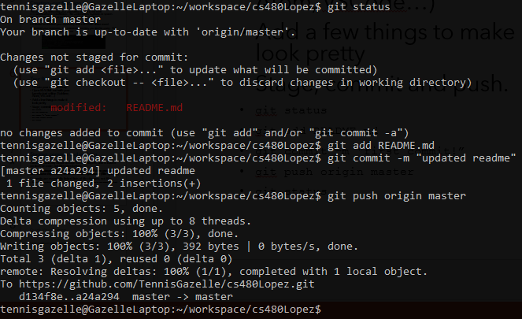
Your first commit
Go into your new directory
Open README.md with your favorite text editor. (Sublime, Atom, VSCode…)
Add a few things to make it look pretty
Stage, commit and push.
git status
git add README.md
git commit –m “first commit!”
git push origin master
git status

Slide 7
New Code
PA0 and PA1 may be found at https://github.com/HPC-Vis/computer-graphics
You can download this code and push it to your repo in two separate ways.
Copy Files Over (easier way)
Download this repository elsewhere
Copy all files to your repository directory
Stage, commit, and push the new files. (git status should tell you what they are)
Change repo’s remote URL
git clone https://github.com/HPC-Vis/computer-graphics
git remote set-url origin https://github.com/<USERNAME>/<REPOSITORY>.git
Don’t forget to remove the original repository you downloaded earlier.

Slide 8

Understanding what you’re doing

Slide 9
Staging, commits and pushing
Github is basically cloud storage for developers, and is based on lines of code, not files themselves.
Files are staged for commit, commited, and then pushed to the remote repository from the local repository (file system)
Commits are essentially linked lists of file changes, not files.
Also worth noting that a commit can have multiple parents (merge commits), and its own unique UUID hash.

Slide 10
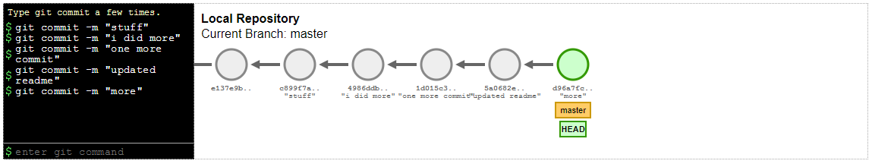
Quick Visualization
https://onlywei.github.io/explain-git-with-d3/#commit

Slide 11
Resources and ProTips

Slide 12
Pro Tip! - .gitignore
.gitignore files are present in the root directory of your repository.
You can specify files to ignore when staging, so your `git status` commands don’t blow up the command line if you have a lot of binaries or photos that you will never intend on commiting.
Resource: https://help.github.com/articles/ignoring-files/

Slide 13
Pro Tip! – Branching and Pull Requests.
If you are comfortable enough with github, you might want to consider branching during group projects to separate work tasks amongst people.
Branches are deviations in the commit tree which get requested to be joined to the master branch through merging, or formally, through pull requests.
These are good for feature management, but merge conflicts are something that may occur. These are common both in industry, so learn to deal with them now!
Resource: https://www.atlassian.com/git/tutorials/comparing-workflows

Slide 14
Contacting Graders
Graders’ Email:
cs480.680@gmail.com
Graders’ GitHub:
cs480-680
Remember to add us as a collaborator! Otherwise, we can’t grade your assignments.

Slide 15
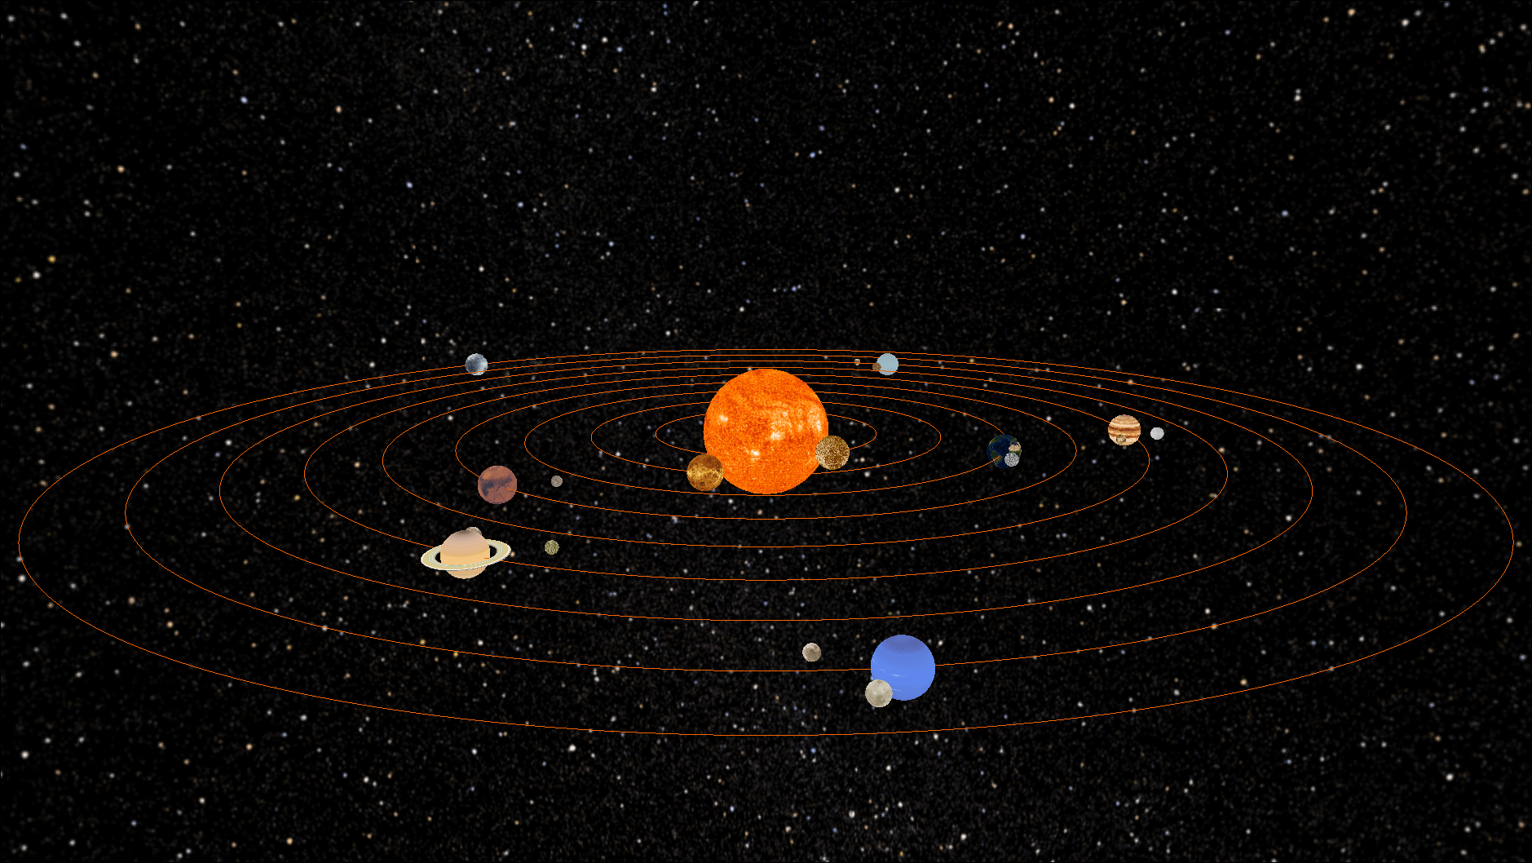
Q&A
Any questions?

